Slide 1


MindCare: Web Portal For Screening Possible Mental Health Issues in Adolescents
MindCare is an AI-powered mental health web application that analyzes user emotions using natural language processing. It predicts potential mental health conditions and offers personalized support through resources like content and articles. Built with the MERN stack, it integrates a fine-tuned Hugging Face model for accurate sentiment analysis.
Mentor – Ms. Shivani (Assistant Professor)
Akanksha Gupta 2100290120022 (CS)
Anushree Ghosh 2100290120041 (CS)
Shifa 2100290130158 (IT)

Slide 2

Project Abstract
Overview
Key Objectives
Approach
MindCare is an AI-powered mental health web application designed to analyze user emotions using natural language processing. It predicts potential mental health conditions and offers personalized support through resources like videos and articles. Built with the MERN stack, it integrates a fine-tuned Hugging Face model for accurate sentiment analysis.
The key objectives of the MindCare project are to detect mental health issues through emotional analysis, provide accurate predictions using AI models, and offer personalized support resources to promote mental well-being and early intervention.
MindCare uses NLP to analyze user input, applies a fine-tuned Hugging Face model for mental health prediction, and delivers personalized support through resources all built on the MERN stack architecture.

Slide 3

Project Goals and Objectives
Early Detection of Mental Health Issues Utilize Natural Language Processing (NLP) and machine learning models to analyze user input and identify potential mental health conditions like anxiety, depression, or stress.
1
Personalized Support and Recommendations Offer customized resources such as videos, mental wellness tips, and relevant articles based on the user’s emotional state and predicted condition.
2
Accessible and Scalable Mental Health Platform Create a responsive, secure, and easily accessible platform using the MERN stack to ensure mental health support is available to users anytime, anywhere.
3

Slide 4
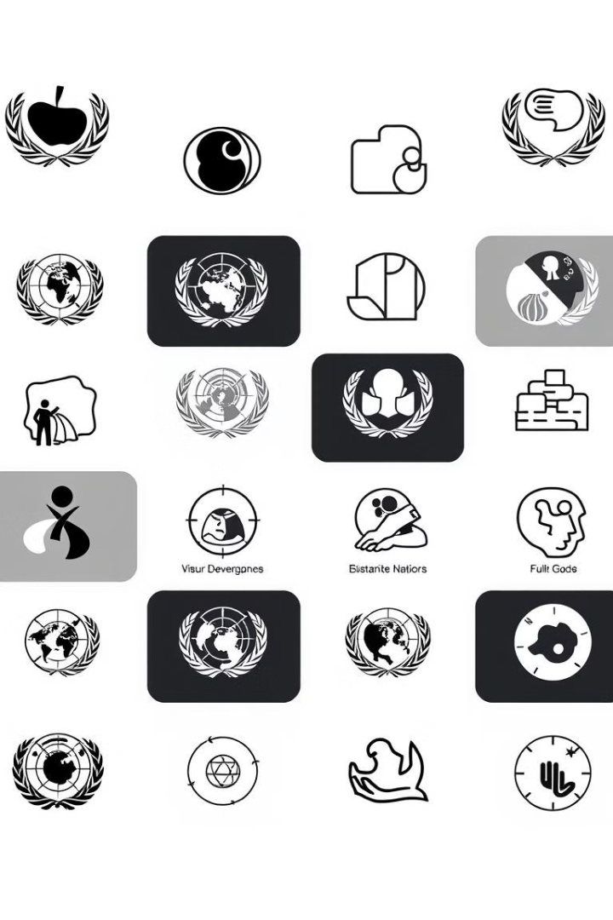
Alignment with UN Sustainable Development Goals (SDGs)
SDG 3 : Good Health and Well-being- Ensure
SDG 9: Industry, Innovation,
and Infrastructure
MindCare promotes mental well-being by identifying potential mental health disorders using a machine learning model, enabling early detection and timely action. It offers personalized care through relevant resources like videos and therapeutic suggestions, encouraging users to seek professional help when needed.
MindCare leverages advanced AI like Hugging Face BERT for accurate mental health prediction, integrating technology and healthcare into an accessible web platform that promotes inclusivity and ensures 24/7 support for all users.

Slide 5

Literature Review
In [1], we found that when applying Hugging Face’s previous BERT looked as effective, there development and application improved our ability to detect emotional signals in mental health related text data. The study demonstrated how fine-tuning BERT, based on labeled datasets of user expressions about stress, anxiety, depression, etc., helped the model grasp the nuances of what it meant to categorize emotion. This discovery lends credence that transformer-based models should play an important role in the detection of a users initial signs of psychological distress from unstructured text. The importance of these findings in the context of the MindCare project cannot be understated in terms of detecting mental health conditions; transformer-based models have been demonstrated to operate with higher levels of accuracy than traditional models including: Naive Bayes, and simplistic RNNs
In [2], we found that a domain-adapted version of BERT that we pre-trained on mental health forums and Reddit datasets, performed better at classifying emotional states. There was better classification because we located language features which had a strong relationship with the domain, such as level of colloquial or idiomatic language that users' exhibiting symptoms of mental disorders would use in their interactions within the forums. Results from these studies support the strong argument for leveraging pre training and adaptation models for specific domains such as mental health, certainly to improve relevance and classification ratings. With MindCare, we are further implementing this promontory level of specialization within the domain to develop a powerful and reliable engine for emotion analysis for interpreting user text inputs, while also detecting the subtleties of these inputs.

Slide 6





Methodology and Approach
Data Collection and Preprocessing
User input in the form of text is collected and preprocessed using Natural Language Processing techniques to clean and tokenize emotional content.
Model Integration and Prediction
A fine-tuned Hugging Face BERT model is used to analyze the processed text and predict potential mental health conditions such as anxiety, depression, or stress.
Personalized Recommendation System
Based on the prediction, MindCare offers tailored resources, including therapy videos, mental health tips, and self-care suggestions to support users’ mental well-being.
Web Platform Deployment
The complete solution is built on the MERN stack (MongoDB, Express, React, Node.js), ensuring a responsive, user-friendly, and scalable platform accessible anytime, anywhere.

Slide 7
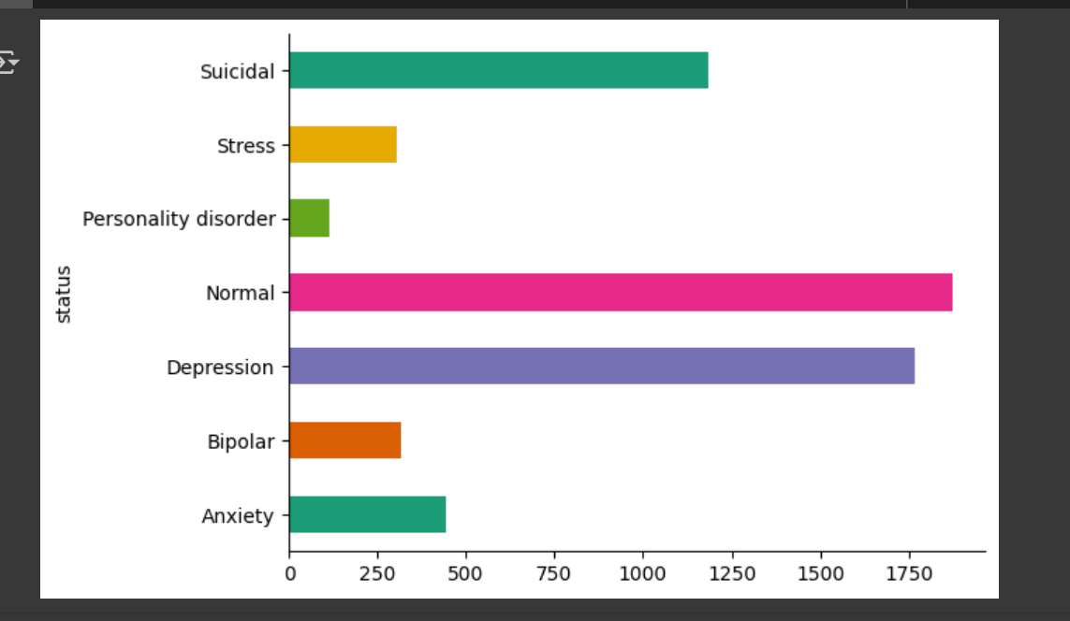



Expected Outcomes and Impact
Early Detection and
Intervention
Improved Mental Health
Awareness
Increased Accessibility to
Mental Health Tools
Users will be able to recognize signs of mental health issues early, enabling timely self-care or professional intervention.
The platform will educate users about mental health, reducing stigma and encouraging open conversations around emotional well-being.
MindCare will provide 24/7 support through an intuitive web platform, making mental health care more inclusive and reachable for diverse user groups.

Slide 8

Key Project Deliverables
AI-Based Mental Health
Prediction Model
Emotion Analysis Module
Personalized Recommendation
Engine
Responsive Web Application

Slide 9

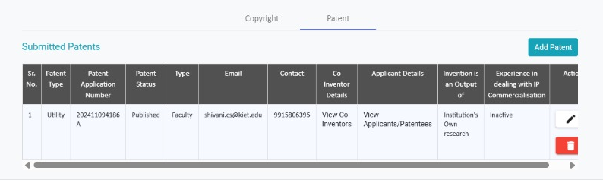
Yukti Portal

Slide 10
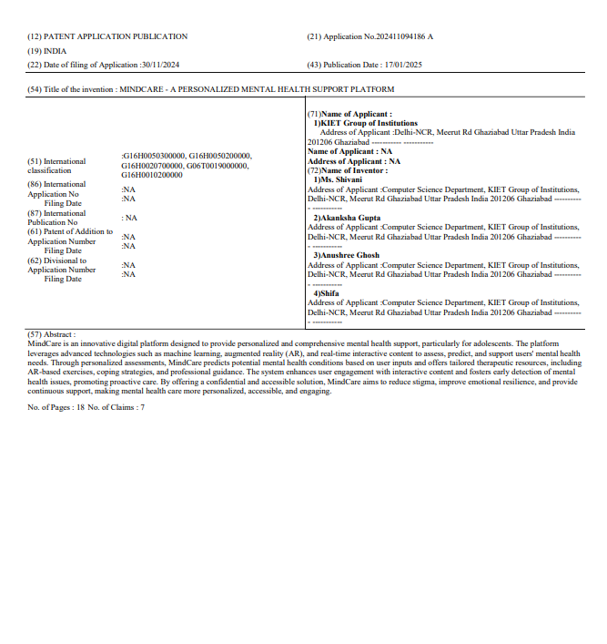

Patent Status

Slide 11

Next Steps
Multilingual Support
Voice and Chatbot
Integration
1
2
Integrate language translation capabilities to cater to users from diverse linguistic backgrounds, making mental health support more inclusive.
Implement AI-powered voice and chatbot features for real-time emotional support and seamless user interaction.
3
Mobile Application Development
Launch a dedicated mobile app to enhance accessibility and provide mental health support on the go.

Slide 12

Reference
[1] A. Pourkeyvan, R. Safa, and A. Sorourkhah, "Harnessing the Power of Hugging Face Transformers for Predicting Mental Health Disorders in Social Networks," IEEE Access, vol. 12, pp. 28025–28035, 2024.
[2] S. Ji et al., "MentalBERT: Publicly Available Pretrained Language Models for Mental Healthcare," arXiv preprint arXiv:2110.15621, 2021.

Slide 13

Conclusion
In conclusion, MindCare is a comprehensive AI-driven platform designed to promote mental well-being through early detection, personalized support, and accessible care. By leveraging advanced NLP models like Hugging Face BERT and a responsive MERN stack interface, it offers a reliable solution for identifying and addressing mental health concerns. With its scalable features and future expansion plans, MindCare holds great potential in transforming digital mental health support and creating greater awareness globally.

